Slide 1
Accurate Computation of Survival Statistics in Genome-wide Studies
Review of manuscript submitted to
PLOS Computational Biology
Fabio Vandin, Alexandra Papoutsaki, Benjamin J. Raphael, Eli Upfal

Slide 2
Introduction to Survival Analysis
Survival time is defined as the length of time that patients live following diagnosis or treatment.
The identification of genetic variants associated with survival time is crucial in genomic studies.
Examples:
Finding genetic alleles that distinguish patients who respond to particular treatments, i.e. live longer.
Finding somatic mutations that distinguish patients with fast-growing tumors that require aggressive treatment from patients with better prognosis.

Slide 3
Goal of survival analysis
Suppose a set $G$ of genes was sequenced in a collection $P$ of patients.
Each sequenced gene $g$ partitions the set of patients into two subsets:
$P(g)$- patients with a mutation in g
$\overline{P}(g)$- patients with no mutation in g.
The goal is to identify genes whose mutational status is highly correlated with the survival time, i.e.: the survival distribution of patients in $P(g)$is different from the survival distribution of patients in $\overline{P}\left(g\right).$

Slide 4
Data censoring
A key challenge in survival analysis is dealing with censored patients whose exact survival time is unknown.
Some fraction of patients remain alive at the conclusion of the study
patients may leave the study during the course of the study for a variety of reasons, that are unrelated to their treatment or disease state.
The censored survival time is the last time the patient was observed in the study, which is a lower bound for the patient’s survival time.
Survival analysis assumes that censoring is non informative (unbiased for certain group).

Slide 5
Survival analysis - Example
Two groups representing different types of brain tumors.
A:21 + G:30 = 51
* indicates censoring

Slide 6
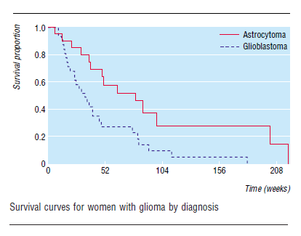
Kaplan-Meier Estimate
The Kaplan–Meier estimator, is an estimator for estimating the survival function from lifetime data.
Used to measure the fraction of patients living for a certain amount of time after treatment.
When there is no censoring, n_{i} is just the number of survivors just prior to time t_{i}. With censoring, n_{i} is the number of survivors minus the number of losses (censored cases).

Slide 7
Kaplan-Meier Estimate
The Kaplan-Meier survival curve is defined as the probability of surviving in a given length of time while considering time in many small intervals.
Assumptions:
At any time, patients who are censored have the same survival prospects as those who continue to be followed.
Same survival probabilities for subjects recruited early and late in the study.
Event happened at the time specified.

Slide 8
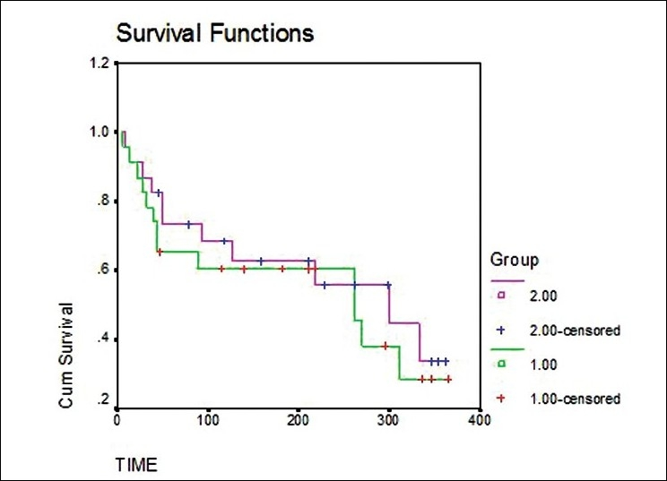
Kaplan-Meier plot with censoring indications

Slide 9
Kaplan-Meier Estimate
But, Is the difference in survival between the two groups significant ?
We could compute survival curves for each group and compare the proportions surviving at any specific time.
The weakness of this approach is that it does not provide a comparison of the total survival experience of the two groups, but rather gives a comparison at some arbitrary time point(s).

Slide 10
The log-rank test
The log-rank test is the most commonly used non-parametric test for comparing the survival distribution of two or more populations with data subject to censoring.
Includes the censored data in its statistic, rather then removing it from the data (important because a large fraction of patients may be censored).

Slide 11
Formulation of the log-rank test
$$P_{0},P_{1}$$ | The two patient groups for which survival distribution is compared
$$t_{1}< t_{2}< … < t_{k}$$ | Times of observed, uncensored events
$$R_{j}$$ | Number of patients at risk at time $t_{j}$ - the number of patients that survived (and were not censored) up to this time
$$R_{j,1 }$$ | Number of $P_{1}$ patients at risk at time $t_{j}$
$$O_{j}$$ | Number of observed uncensored events in the interval $\left[t_{j−1}, t_{j}\right]$
$$O_{j,1}$$ | Number of these events in group $P_{1}$
$$Assuming equal survival distributions of P_{0} and P_{1}, then in expectation:$$
$$The log rank statistic measures the sum of deviations of O_{j,1}$$
$$from the above equal distribution expectation:$$

Slide 12
Calculation of log-rank statistic - Example
$$O_{1}=1 ;R_{1}=51 ; {{ O}_{1,1}=1 ; R}_{1,1}=20 ;$$
The first death was in week 6, when one patient in group 1 died.
There were 20 patients in group 1, so, if the null hypothesis were true, the expected number of deaths in group 1 is: $1 ∗\frac{20}{51}= 0.39$.

Slide 13
Calculation of log-rank statistic - Example
$$O_{2}=2 ;R_{2}=50 ; {{ O}_{2,1}=1 ; R}_{2,1}=19 ;$$
The second event occurred in week 10, when there were two deaths.
There were now 19 and 31 patients at risk (alive) in the two groups.
Expected number of deaths in group 1 is: $2 ∗\frac{19}{50}=0.76$
We continue and sum the deviations from the expectation over all events to get the log-rank statistic.

Slide 14
The log-rank test
The log-rank test has two versions:
Permutational Log-Rank Test
Null distribution is obtained by assigning each patient to population $P_{0}$ or $P_{1}$ independently of the survival time.
Considering all $\left({n \atop n_{1}}\right)$ possible selection of survival times and censoring information from observed data for the $n_{1}$ patients of group $P_{1}.$
Found to be “more accurate in genomics settings”.
Conditional Log-Rank Test
If at time$t_{j}$there are a total of $R_{j}$ patients at risk, including $R_{j,1}$patients in $P_{1}$, then under the assumption of no difference in the survival of $P_{0}$ and $P_{1}$ the $O_{j}$events at time $t_{j}$ are split between $P_{0}$ and $P_{1}$ according to a hypergeometric distribution with parameters $R_{j}$ , $R_{j,1}$, and $O_{j}$.

Slide 15
Problems with current implementations of the log-rank test when applied to genomic studies
Unlike in clinical trials , in genomic studies one patient group can be significantly smaller than the other (i.e. certain SNP found only in 5% of the patients).
Unfortunately, in this setting of unbalanced populations, the normal approximation of the log-rank statistic gives poor results.
Multiple-hypothesis correction which is often applied in genomic studies, requires highly-accurate p-values.
An inaccurate approximation of p-values will result in an unacceptable number of false positives/negative associations of genomic features with survival

Slide 16
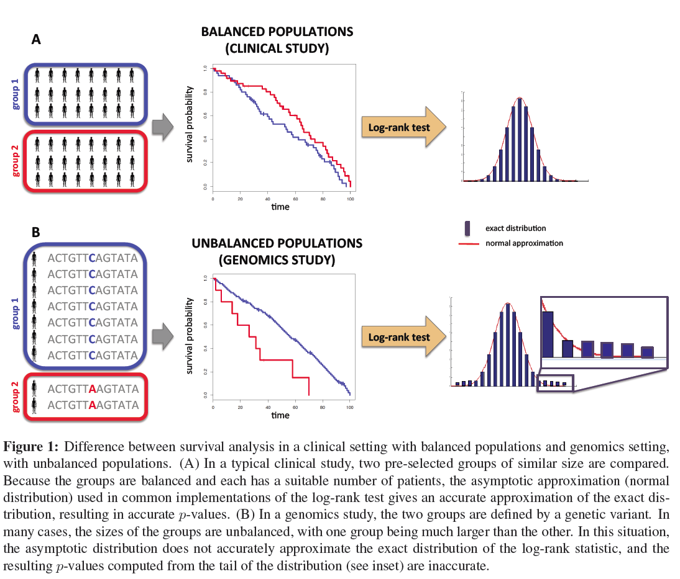

Slide 17
Challenges in developing a test based on an exact distribution
Multiple observed features (survival and censoring times) that determine the exact distribution make it infeasible to pre-compute distribution tables for the test.
The very small p-values required are expansive to compute using standard Monte-Carlo methods.
No efficient algorithm is known to compute the p-value of the log-rank test under the exact permutational distribution).

Slide 18
The ExaLT Algorithm Exact Log-rank Test
Computes the p-value of the log-rank statistic under the exact permutational distribution.
Fully polynomial time approximation scheme (FPTAS).
Gives an explicit bound on the error in approximating the true p-value, for any given sample size.
Always provides a conservative or a valid p-value estimate.

Slide 19
Vector representation of the log-rank test
Since the log-rank statistic depends only on the order of the events, we can w.l.o.g. treat the survival data as an ordered sequence of events.
Let $n_{j}=|P_{j}|$, for j = 0,1, be the number of patients in each population
let $n = n_{0}+n_{1}$be the total number of patients.
We can represent the data by two binary vectors:
$x∈{\left\{0,1\right\}}^{n} −where x_{i}= 1 if the i^{th} event was in P_{1} and x_{i}=0 otherwise\text{;}$
$c∈{\left\{0,1\right\}}^{n} −where c_{i}=0 if the i^{th}event was censored and c_{i}=1 otherwise$
In this notation, the log rank statistic is:

Slide 20
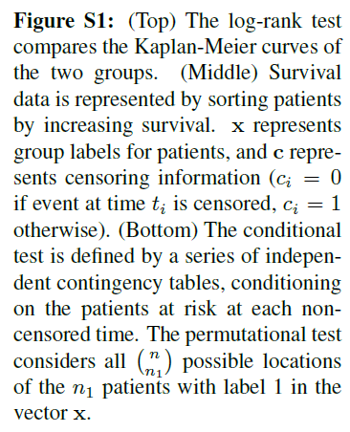
Vector representation of the log-rank test

Slide 21
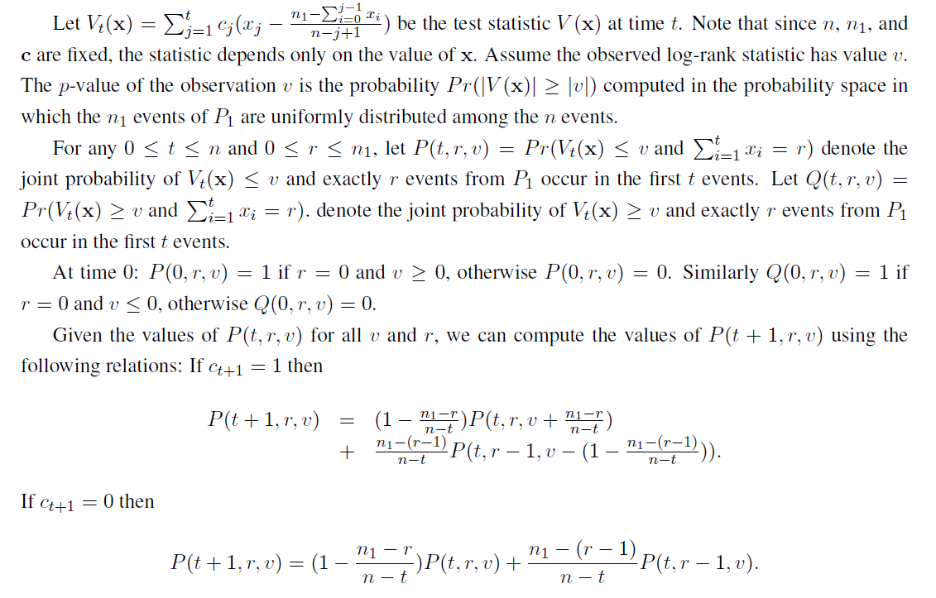
Calculating the p-values using step functions

Slide 22
Computing the probabilities of only a polynomial number of values in each iteration.
The approximation algorithm estimates $P(t, r, v)$ with a step function $\tilde{P} (t,r,v)$defined by a sequence of points $v_{k,r}^{t} , k = 0..l,$such that $v_{k,r}^{t}$is an estimate for the largest v such that $P\left(t, r, v\right)≤{\left(1−ε_{1}\right)}^{k}.$
Thus, after n iterations we have an $ε−approximations$for $P(n, n1, v).$

Slide 23
Results

Slide 24
Accuracy of Asymptotic Approximations
Started by demonstrating the inaccuracy of current implementations that are based on asymptotic approximation for the log-rank test.
Generated data of a cohort of 500 patients with a gene g mutated in 5% of these patients.
No real difference in survival distribution.

Slide 25
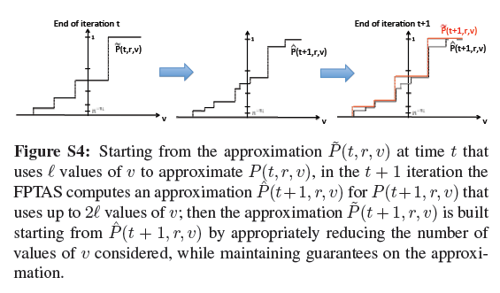

Slide 26
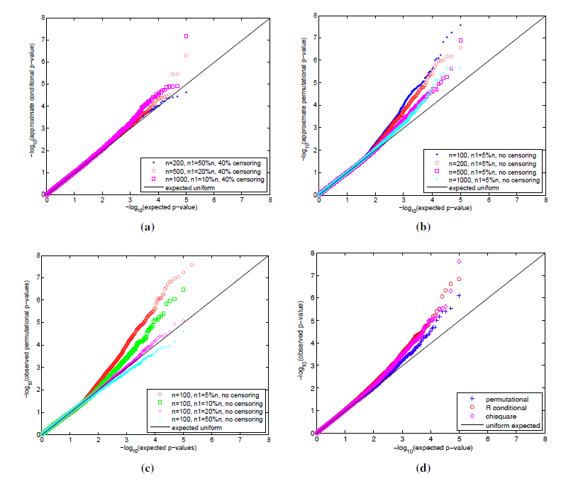
Accuracy of Asymptotic Approximations
Comparison of the p-values from asymptotic approximations and the uniform distribution
(B): When the imbalance between populations increases, the accuracy of the asymptotic approximation decreases.

Slide 27
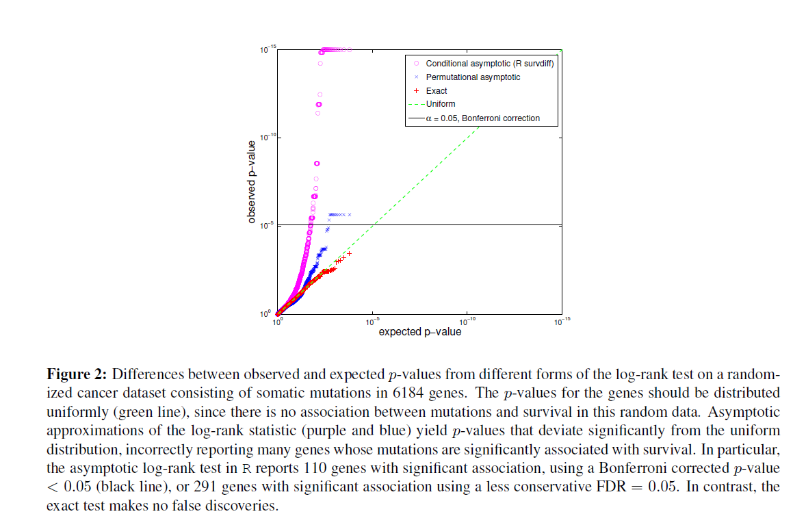
Comparison on randomized cancer dataset

Slide 28
Comparing ExaLT’s p-values to those reported by 3 published cancer studies
Compared the p-values from the exact distribution to p-values from the asymptotic approximation reported.
ExaLT’s p-values were higher than the p-values reported in two papers (What does it prove?)
ExaLT’s p-values were lower than those reported in a third paper, and indeed the identified genes reported by three other studies.

Slide 29
TCGA Cancer data
Analyzed somatic mutation and survival data from studies of six different cancer types.
For each mutated gene, compared the p-value obtained using the asymptotic approximation as computed by the R package survdiff to the exact p-value as computed by ExaLT.

Slide 30
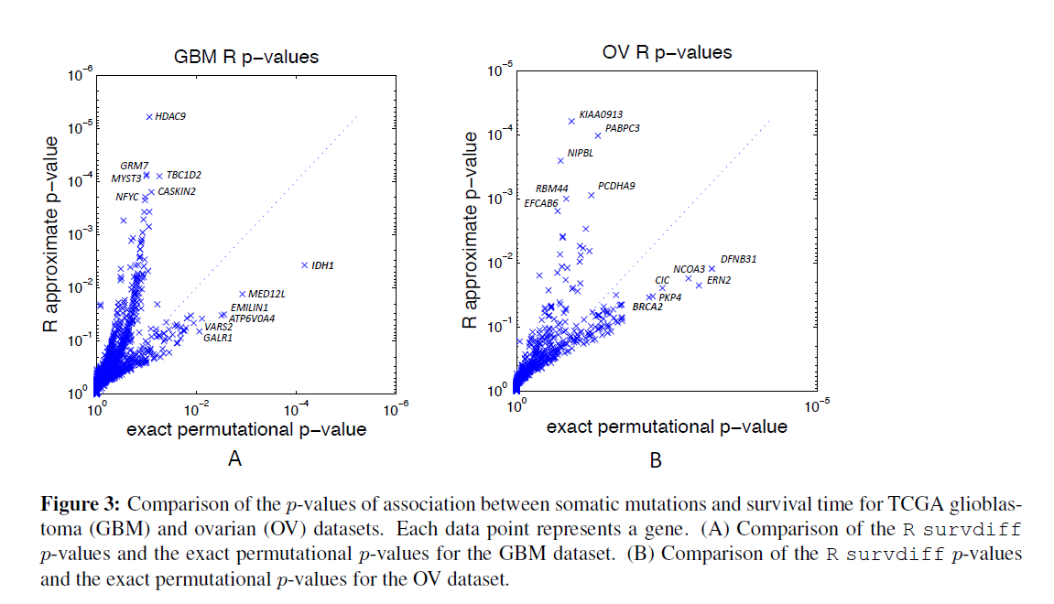
Comparison on TCGA data
Very different p-values
No overlap in top 25 genes on GBM dataset
Several top 10 ExaLT’s genes are associated with survival, but non of the approx. are known.
Known genes are ranked low on approx. list.

Slide 31
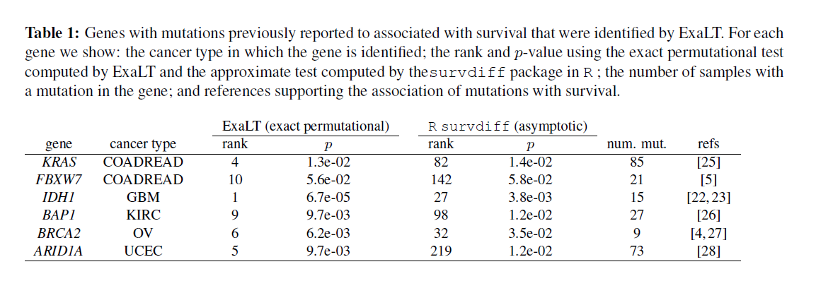
ExaLT better ranks known cancer related genes when applied on TCGA data
“Thus, the exact test implemented by ExaLT appears to have higher sensitivity and specificity in detecting mutations associated with survival on the sizes of cohorts analyzed in TCGA. “

Slide 32
Summary
The paper addresses an important but neglected problem.
Very well written.
Method was tested on both synthetic, randomized and real genomic datasets, yielding good results.
Method is supported by mathematical formulation.
Implementation is provided.
Some of the demonstrations are not convincing.
Recommendation: ACCEPT

